Slide 1

Structured Analysis of Business Processes
(Chapter 05)
MIS 372 Spring 2022

Slide 2

Do Check-in First
https://forms.office.com/r/nwsEdTduTE

Slide 3
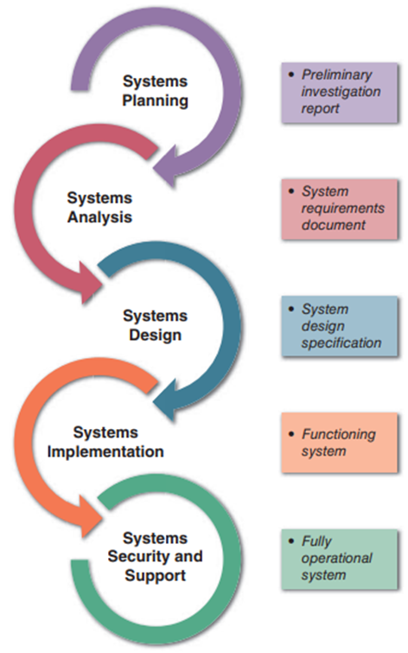
Where We Are in SDLC

Slide 4
Learning Objectives
1. Process Description and Modular Design
2. Structured English
3. Decision Tables
4. Decision Trees

Slide 5
1. Process Description and Modular Design
A process description documents the details of a process and represents a specific set of processing steps and business logic.
Process Description
Modular Design
Structured English
Decision Tables
Decision Trees
“Gateway” logic and three tools

Slide 6
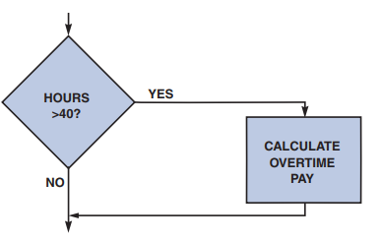
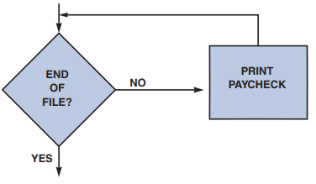
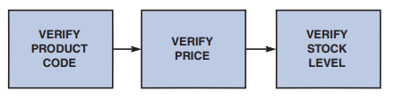
Modular Design
All processes should be able to describe using the modular design perspective.
It decomposes a process with a combination of three logical structures (or control structures)
Sequence Structure
Selection Structure
Iteration Structure

Slide 7
2. Structured English
Used when the process logic involves formulas or iteration, or when structured decisions are not complex
Based on structured logic and simple English statements such as add, multiply, and move

Slide 8
An Example – ‘Verify Order’ Process
Description: Accept or reject customer order based on credit status and product availability
Process Description:
Input data flows: ORDER, CREDIT STATUS, PRODUCT DETAIL
Output data flows: REJECTED ORDER, ACCEPTED ORDER
For each ORDER
If CUSTOMER STATUS CODE = Y and PRODUCT DETAIL = OK
Output ACCEPTED ORDER
Else
Output REJECTED ORDER

Slide 9
Writing Structured English
Express all logic in terms of sequential structures, decision structures, case structures, or iterations
Use and capitalize accepted keywords such as IF, THEN, ELSE, DO, and PERFORM
Indent blocks of statements to show their hierarchy (nesting) clearly
Underline words or phrases that have been defined in a data dictionary
Clarify the logical statements

Slide 10
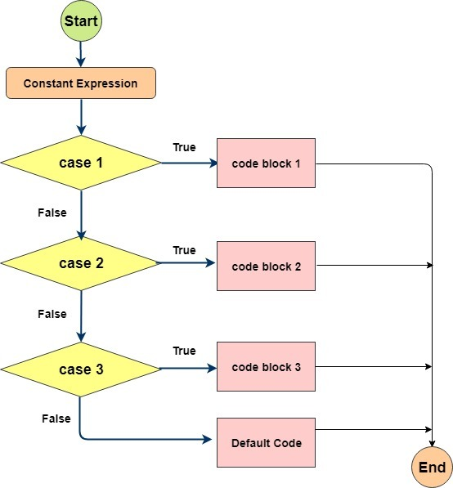
Syntax Reference
Structured English Type | Example
Sequential Structure A block of instructions in which no branching occurs | Action #1 Action #2 Action #3
Decision Structure Only IF a condition is true, complete the following statements; otherwise, jump to the ELSE | IF Condition A is True THEN implement Action A ELSE implement Action B ENDIF
Case Structure A special type of decision structure in which the cases are mutually exclusive (if one occurs, the others cannot) | IF Case #1 Implement Action #1 ELSE IF Case #2 Implement Action #2 ELSE IF Case #3 Implement Action #3 ELSE IF Case #4 Implement Action #4 ELSE print error ENDIF
Iteration Blocks of statements that are repeated until done | DO WHILE there are customers. Action #1 ENDDO

Slide 11
3. Decision Tables
A process may pursue different actions based on one or combination of two or more factors.
A decision table can be used to display the logical structure that shows every combination of conditions and outcomes
Number of rules doubles each time a condition is added (2^n)

Slide 12
A Process with One Condition
Example process – VERIFY ORDER
IF CREDIT SCORE < 700 THEN, Reject Order ELSE Accept Order

Slide 13
A Process with One Condition
Example process – VERIFY ORDER
IF Credit Status is OK THEN, Accept Order ELSE Reject Order
 | 1 | 2
CREDIT STATUS | Y | N
Accept Order | X
Reject Order |  | X

Slide 14
A Process with Two Conditions
Example process – VERIFY ORDER
IF Credit Status is OK AND Product is in Stock THEN, Accept Order ELSE Reject Order
 | 1 | 2 | 3 | 4
CREDIT STATUS | Y | Y | N | N
Product is in stock | Y | N | Y | N
Accept Order | X
Reject Order |  | X | X | X

Slide 15
A Process with Three Conditions
Example process – VERIFY ORDER
IF (Credit Status is OK OR Credit override) AND Product is in Stock THEN, Accept Order ELSE Reject Order
 | 1 | 2 | 3 | 4 | 5 | 6 | 7 | 8
CREDIT STATUS | Y | Y | Y | Y | N | N | N | N
Product is in stock | Y | Y | N | N | Y | Y | N | N
Credit waiver eligible | Y | N | Y | N | Y | N | Y | N
Accept Order | X | X |  |  | X
Reject Order |  |  | X | X |  | X | X | X

Slide 16
Simplifying a Complex Table
 | 1 | 2 | 3 | 4 | 5 | 6 | 7 | 8
CREDIT STATUS | Y | Y | - | - | N | N | - | -
Product is in stock | Y | Y | N | N | Y | Y | N | N
Credit waiver eligible | - | - | - | - | Y | N | - | -
Accept Order | X | X |  |  | X
Reject Order |  |  | X | X |  | X | X | X
 | 1 | 2 | 3 | 4
CREDIT STATUS | Y | N | N | -
Product is in stock | Y | Y | Y | N
Credit waiver eligible | - | Y | N | -
Accept Order | X | X
Reject Order |  |  | X | X

Slide 17
Multiple Outcomes Tables
Example process – Sales Promotion Policy
Preferred customers who order $1,000 or more are entitled to a 5% discount and an additional 5% discount if they use our charge card.
Preferred customers who do not order $1,000 or more will receive a $25 bonus coupon.
All other customers will receive $5 bonus coupon.
Can you turn this into a structured English?

Slide 18
Structured English for Multiple Outcomes
IF NOT preferred customers
THEN receive $5 coupon
ELSE
IF purchase < $1,000
THEN receive $25 coupon
ELSE
IF our charge card used NO
THEN receive 5% discount
ELSE
receive 5% + 5% discount

Slide 19
Decision Table for Multiple Outcomes
 | 1 | 2 | 3 | 4 | 5 | 6 | 7 | 8
Preferred Customer | Y | Y | Y | Y | N | N | N | N
Ordered $1,000 or more | Y | Y | N | N | Y | Y | N | N
Used our charge card | Y | N | Y | N | Y | N | Y | N
5% discount | X | X
Additional 5% discount | X
$25 bonus coupon |  |  | X | X
$5 bonus coupon |  |  |  |  | X | X | X | X
Can you simplify this table?

Slide 20
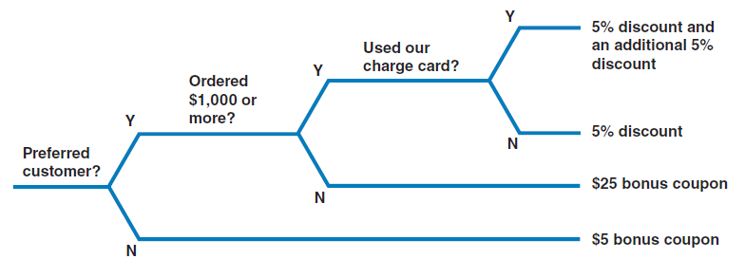
4. Decision Trees
Graphical representation of conditions, actions, and rules found in a decision table

